Slide 1
functions, input & output, importing modules.
Week 1 | Lecture 2 (1.2.1)
While waiting for class to start:
Download and open the Jupyter Notebook (.ipynb) for Lecture 1.2.1
You may also use this lecture’s JupyterHub link instead (although opening it locally is encouraged).
Upcoming:
Lab 1 released (Gradescope invites coming...)
Reflection 1 released Friday
PRA (Lab) on Friday @ 2PM this week

Slide 2
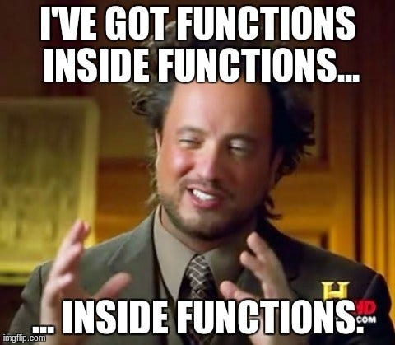
What you’ll learn today
Lecture 2.1
Functions, input & output, importing modules
Lecture 2.2
Writing your own functions

Slide 3
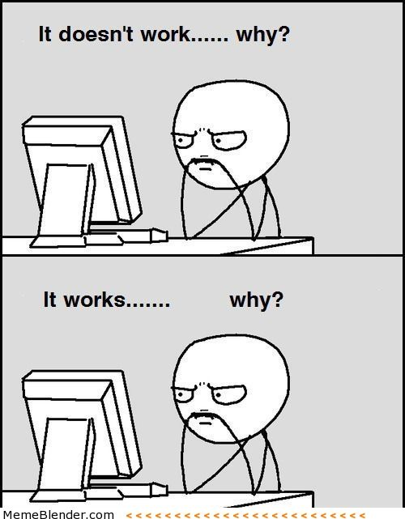
Programming Guide 101
Readability
If nothing else, write #cleancode
Comments
Save yourself from yourself
Lots of testing!
Modular code (you will learn about functions next week)
Test often and with purpose
Understanding errors
Types of errors
Error codes
Always have a plan!

Slide 4
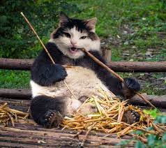
Readability Tips (#cleancode)
>>> canda = cat + panda
Use whitespace to separate variables and operators
>>> canda=cat+panda
Be consistent with spacing, too much whitespace can be bad
>>> canda = cat +panda
Pick variable names that are easy to read and interpret
>>> canda = nom + nomnomnomnomnom
Be consistent with naming schemes
>>> Canda = CAT + _panda42

Slide 5
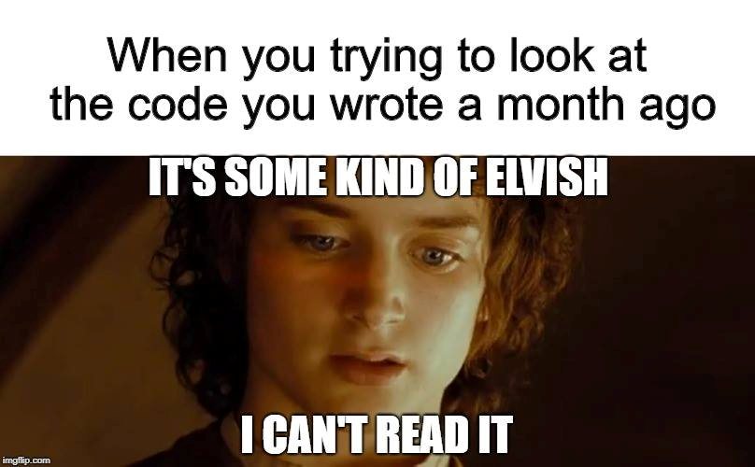
Comments
Comments are to help you, and anyone else who is reading/using your code, to remember or understand the purpose of a given variable or function in a program.
A comment begins with the number sign (#) and goes until the end of the line.
Python ignores any lines that start with the (#) character

Slide 6
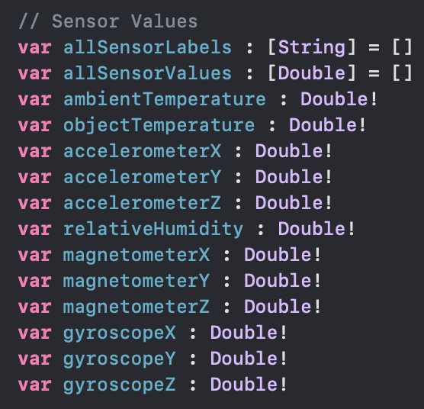
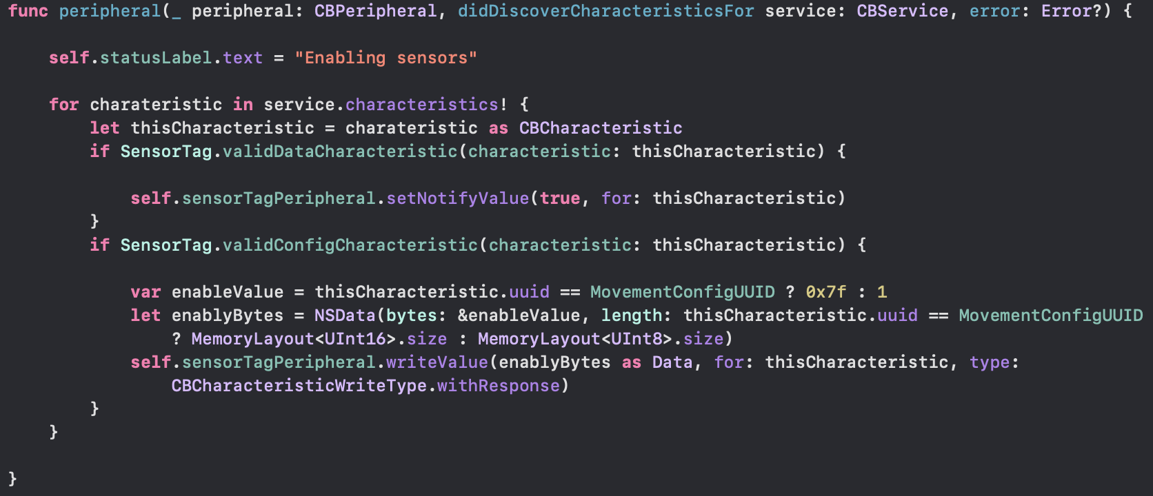
Warning! This is not Python! It is an example from one of my iOS apps I had to come back to after a few years. Comments are (//) in Swift instead of (#) in Python

Slide 7
Testing!
The more lines of code you write, the more likely it is that you will make a mistake and the harder it will be to find the mistake
“like finding a needle in a haystack”
Test your code as you write it
Requires you understanding what specific output an input will provide
”Modular code”
Test in small chunks or “modules”
Put a test input into the beginning where you know what the output is and see what you get!
Golden Rule: Never spend more than 15 minutes programming without testing

Slide 8
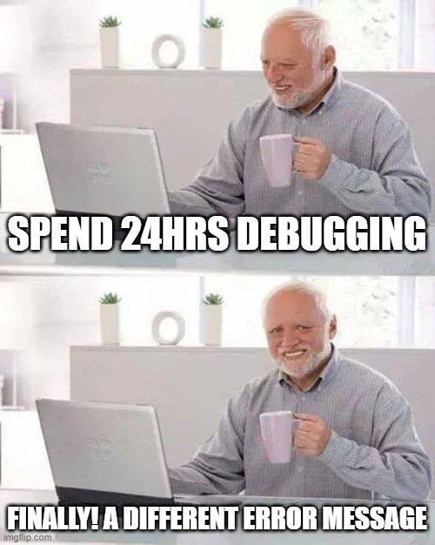
Error Reduction vs Debugging
It is pretty much impossible to write code without errors.
Error Reduction: techniques we can use to reduce the number and severity of errors.
Debugging: techniques for identifying and correcting errors
How Does That Work? Video

Slide 9
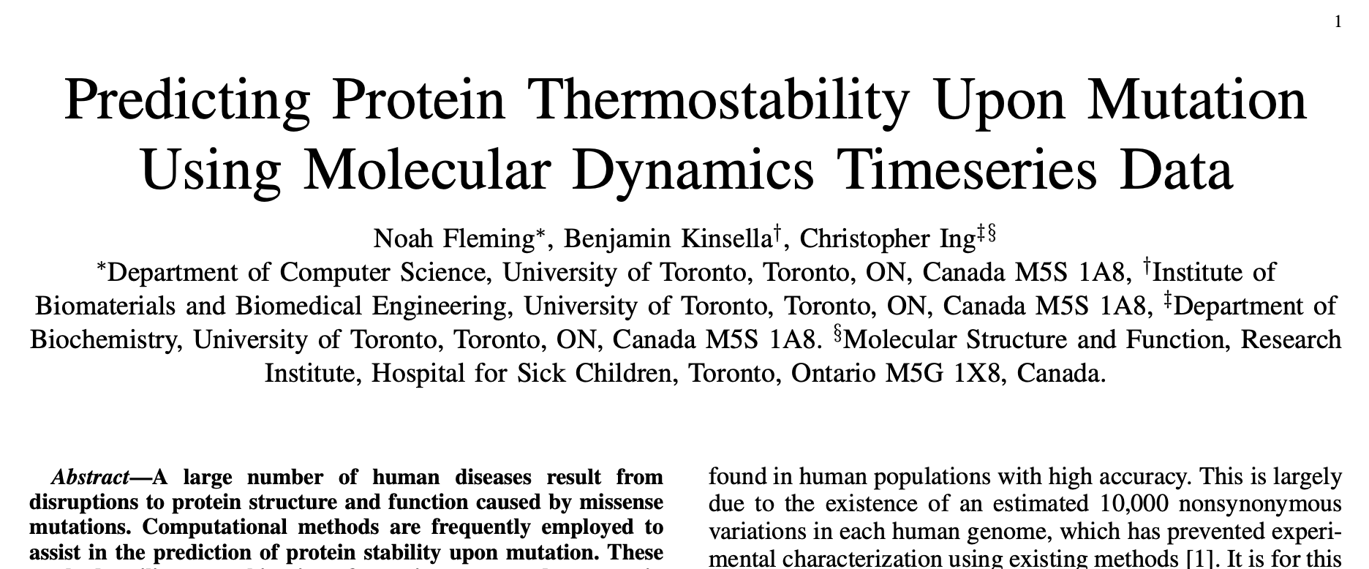

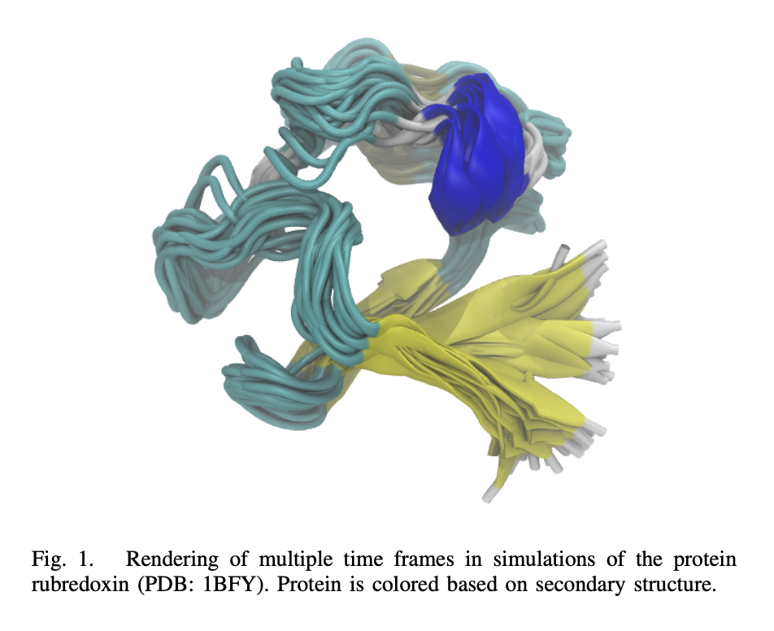
Code Efficiency
Supercomputer in Quebec
Notes:
Everything you’re running right now seems to be almost instant – which is nice. But when you get to later labs, or even when we get to loops that run many times, you might notice a lag in your results. That lag might only be a few seconds, but as that program gets bigger, or you have to run the same piece of code on multiple data points, 1 second can turn into minutes or hours. In the real world, time is money. From my personal experience, one project I worked on with a group from SickKids was predicting if a mutation was cancerous based on the stability of a protein molecule. We were using neural networks and millions of datapoints – and if I were to press run on my code on my computer I’d have to wait hours, sometimes overnight, just to get one result and see if it worked or not. How we actually got all our results, for all our thousands of datapoints was renting out server space in a supercomputer in Montreal, but every hour of server space rented might cost you hundreds or thousands of dollars, so code efficiency is super important. The more code you can get through in an hour of server space you can save money and time.

Slide 10
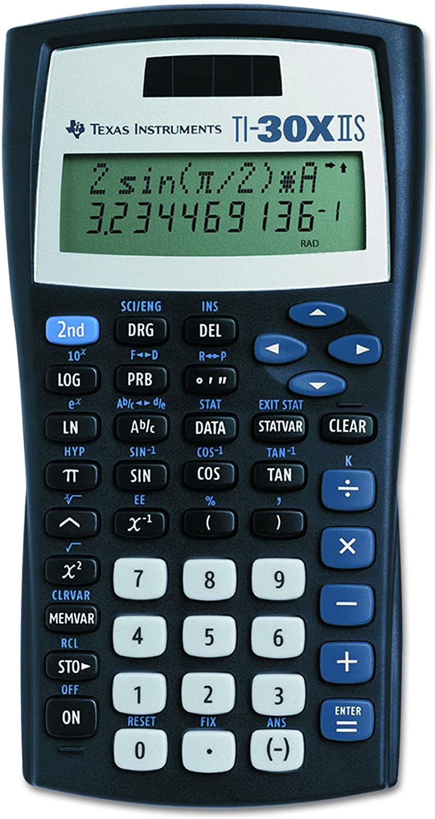
What is a function?
A function is a piece of code that you can “call” repeatedly to do one thing.
Think about the sin key on your calculator. It takes in an angle, does some calculations and returns the sine of that angle.
Python has built-in functions (today), but programmers can also create their own user-defined functions (next lecture).

Slide 11


Slide 12
Why do we write functions?
Let’s consider our sine function.
In Python, this could take 10 or more line of code to compute.
If you have to compute the sine of an angle multiple times in your code, this means you have to repeat the same 10 lines of code over and over and OVER again!
This is both inefficient and it creates more opportunities to bugs (mistakes) to creep into your code.
Open your notebook
Click Link:
1. Why do we write functions?

Slide 13
Why do we write functions?
Reuse:
The practice of using the same piece of code in multiple applications.
Abstraction:
A technique for managing the complexity of the code (how much do we really need to know?).
model.fit(X, y) → This could train a deep neural network.
Collaboration:
Easy to read, Easy to modify, Easy to maintain.
#cleancode

Slide 14
Calling Functions
In Python names of variables and functions use low case and underscores.
function_name
Function_Name
FunctionName
"snake case" or
"pothole case“?
The general form of a function call:
Terminology
argument: a value given to a function.
pass: to provide an argument to a function.
call: ask Python to execute a function (by name).
return: give a value back to where the function was called from.
function_name(arguments)
function_name()
function_name
Would not result in a function call.

Slide 15
Calling Functions
The stuff we pass to the function.
Arguments
The general form of a function call:
Terminology
argument: a value given to a function.
pass: to provide an argument to a function.
call: ask Python to execute a function (by name).
return: give a value back to where the function was called from.
function_name(arguments)
Function
Call
Function
()
function_name()
function_name
Would not result in a function call.
The stuff the function returns to us after we call it.
Returns

Slide 16
Calling Functions
Open your notebook
Click Link:
2. Function Call
The general form of a function call:
Terminology
argument: a value given to a function.
pass: to provide an argument to a function.
call: ask Python to execute a function (by name).
return: give a value back to where the function was called from.
function_name(arguments)

Slide 17
Back to evaluation and expressions
Last week we learned about the assignment statement (=).
Remember, the value of the expression on the right-hand side (RHS) of the = sign is figured out first and then assigned to the variable on the left-hand side.
This also applies if the thing on the RHS is a function!
First, the function is called while passing it an argument.
x = abs(-20+5)
Then, what the function returns is assigned to x.

Slide 18
Back to evaluation and expressions
x = abs(-20+5)
Last week we learned about the assignment statement (=).
Remember, the value of the expression on the right-hand side (RHS) of the = sign is figured out first and then assigned to the variable on the left-hand side.
This also applies if the thing on the RHS is a function!
The stuff we pass to the function.
Arguments
?
Function
?
The stuff the function returns to us after we call it.
Returns
?

Slide 19
Back to evaluation and expressions
x = abs(-20+5)
Last week we learned about the assignment statement (=).
Remember, the value of the expression on the right-hand side (RHS) of the = sign is figured out first and then assigned to the variable on the left-hand side.
This also applies if the thing on the RHS is a function!
The stuff we pass to the function.
Arguments
-15
Function
abs
The stuff the function returns to us after we call it.
Returns
15

Slide 20
Back to evaluation and expressions
Last week we learned about the assignment statement (=).
Remember, the value of the expression on the right-hand side (RHS) of the = sign is figured out first and then assigned to the variable on the left-hand side.
This also applies if the thing on the RHS is a function!
Open your notebook
Click Link:
3. Back to Evaluation and Expressions

Slide 21
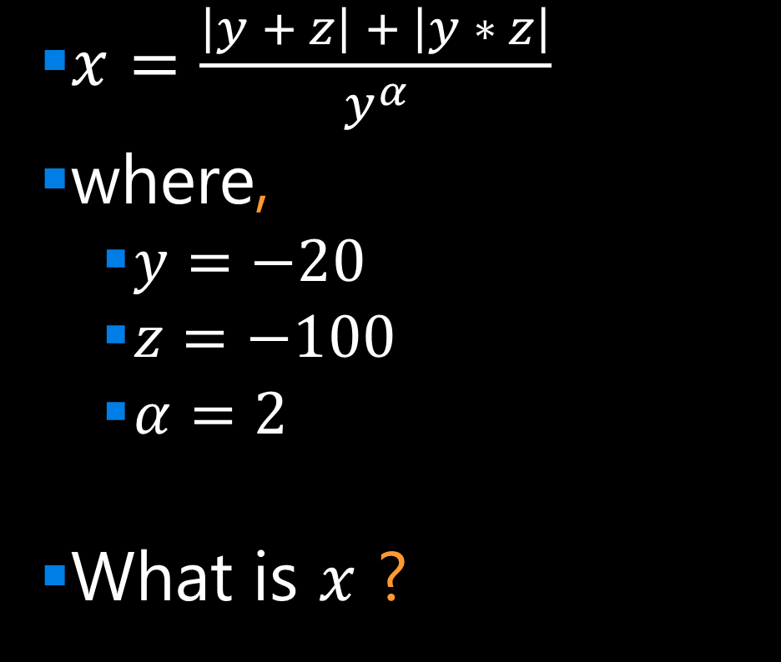
Breakout Session 1
$x=\frac{\left|y + z\right| + \left|y ∗ z\right|}{y^{α}}$
where,
$y=−20$
$z=−100$
$α=2$
What is $x$ ?
Open your notebook
Click Link:
4. Breakout Session 1

Slide 22
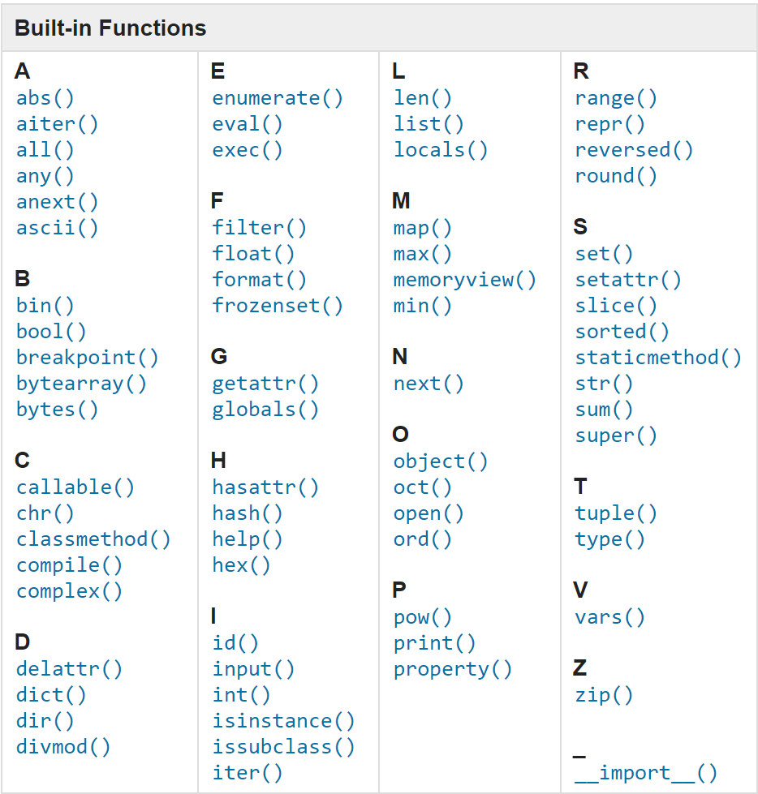
Built-in Functions
The function_name is the name of the function (like sin or print).
Python has many built-in functions. Learn more about them here.

Slide 23
Built-in Functions
The function_name is the name of the function (like sin or print).
Python has many built-in functions. Learn more about them here.
Open your notebook
Click Link:
5. Built-in Functions

Slide 24
Function Help
To get information about a particular function, call help and pass the function as the argument.
help is one of Python’s built-in functions.
help(abs)
help(abs())
Open your notebook
Click Link:
6. Function Help
Notice how we’re not calling the function.

Slide 25
Output
Python has a built-in function named print for displaying messages to the user.
The general form of a print function call:
The arguments can be of type int, float, strings and others we will discuss next week.
Open your notebook
Click Link:
7. Output
print(arguments)

Slide 26
Input
Python has a built-in function named input for reading inputs from the user.
The general form of an input function call:
The argument is the text you want displayed to the user.
“What is your name?”
The value returned by the input function is always a string.
Open your notebook
Click Link:
8. Input
input(argument)

Slide 27
Breakout Session 2
Write code to print out the following text:
Where you see curly brackets {} you need to use the input function to prompt the user to enter that information.
Open your notebook
Click Link:
9. Breakout Session 2
"Hello, my name is {} and I'm hoping to get a grade of {} in APS106 this term."

Slide 28
Importing Functions and Modules
Not all useful functions are built-in and they must be imported.
Groups of functions are stored in separate Python files, which are called modules.
Some modules come pre-installed with Python and other need to be installed separately.
For example, there are a lot of machine learning methods implemented in the scikit-learn modules.
To get access to the functions in a module, you need to import the module.

Slide 29
Importing Functions and Modules
The general for of an import statement is:
import module_name
To access a function within a module:
module_name.function_name
The dot is an operator:
Look up the object that the variable to the left of the dot refers to.
In that object, find the name that occurs to the right of the dot.
import math
math.sqrt(16)

Slide 30
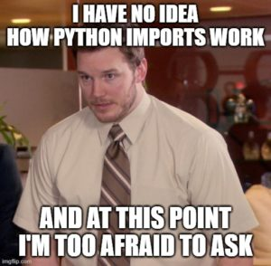
Importing Functions and Modules
The general for of an import statement is:
import module_name
To access a function within a module:
module_name.function_name
Open your notebook
Click Link:
10. Importing Function and Modules

Slide 31
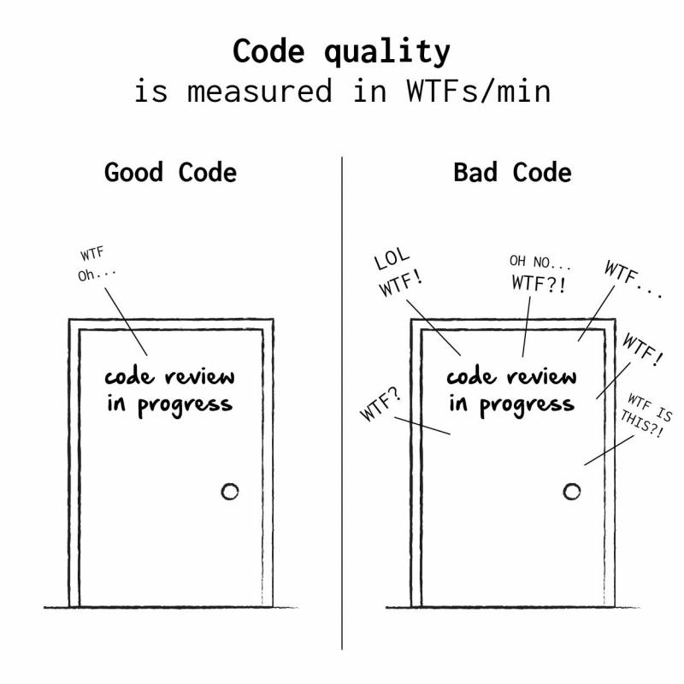
Defining Your Own Functions
The real power of functions is in defining your own.
Good programs typically consist of many small functions that call each other.
If you have a function that does only one thing (like calculate the sine of an angle), it is likely not too large.
If its not too large, it will be easy to test and maintain.

Slide 32
Defining Your Own Functions
As a general rule, you should not write functions more than a 30 or 40 lines.
Smaller is better: 10 or less is good.
If you need something bigger, break it up into multiple functions.
#cleancode

Slide 33
Function Definitions
The general form of a function definition is:
def is a keyword, standing for definition. All function definitions must begin with def. The def statement must end with a colon.
function_name is the name you will use to call the function (like sin, abs but you need to create your own name).
parameters are the variables that get values when you call the function. You can have 0 or more parameters, separated by commas. Must be in parenthesis.
body is a sequence of commands like we've already seen (assignment, multiplication, function calls).
Important: all the lines of body must be indented. That is how Python knows that they are part of the function.
def function_name(parameters):
body
Colon
Indent
(parameter1, parameter2, …)

Slide 34
Function Definitions
The general form of a function definition is:
Open your notebook
Click Link:
11. Defining Your Own Functions
Definition
Function Name
Colon
def function_body(parameters):
body
Indent
(parameter1, parameter2, …)

Slide 35
functions, input & output, importing modules.
Week 1 | Lecture 2 (1.2.1)

